Slide 1

Rockbuster Stealth LLC Launch Strategy Analysis
This presentation provides strategic insights derived from customer data to inform business decisions.

Slide 2

Overview
Rockbuster Data Insights: Unlocking Customer Trends for Growth.
Customer Rental Trends: Understanding rental frequency, popular genres, and peak rental periods..
Revenue Insights: Identifying top-performing regions and customer segments driving revenue.
Market Expansion Opportunities: Analyzing geographic trends to inform potential new market strategies.
This presentation provides key insights derived from Rockbuster customer data to help inform strategic business decisions. Our analysis covers.

Slide 3
Customer Distribution
Customer Distribution Insights: Analyzing Geographic Trends for Growth.
Exploring the geographic spread of our customer base across various countries and cities.
Identifying key regions with the highest customer concentration and market potential.
Analyzing distribution trends to uncover strategic growth opportunities.

Slide 4
Top Performing Countries and Cities
Top Performing Countries & Cities: Insights on Customers and Revenue.
Detailed analysis of the top 10 countries with the highest customer count.
Identifying cities that drive the most revenue for Rockbuster.
Uncovering trends and patterns in customer behavior across these regions.

Slide 5
Top Customers: Revenue Leaders
Top Customers: Key Contributors to Revenue.
Identifying the top 5 customers who have contributed the most in terms of revenue.
Analyzing customer behavior and purchasing patterns to understand their value.
Highlighting strategies to retain and engage high-value customers.

Slide 6
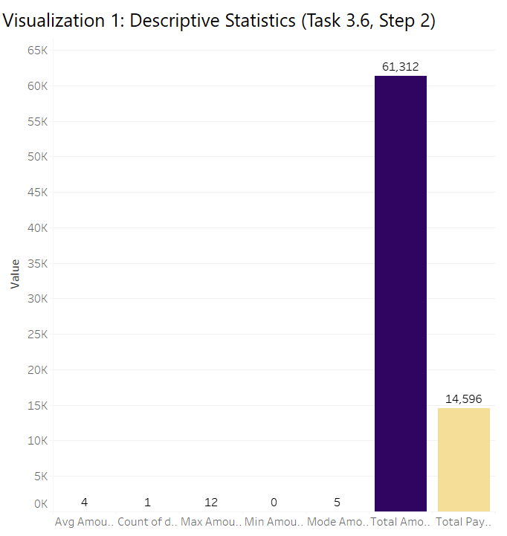
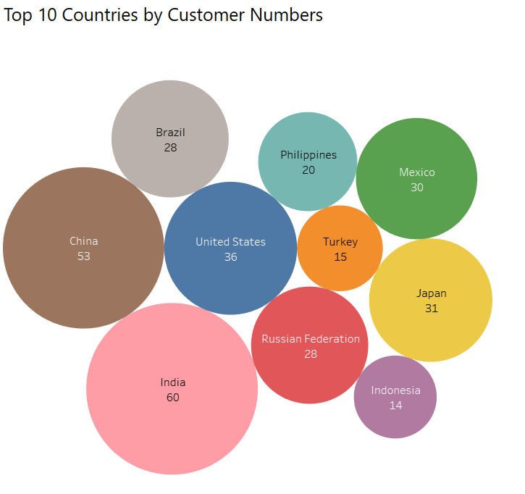
Visualizations and Insights

Slide 7
Overview of Payment Data
Descriptive Statistics of Payment Amounts. Top 10 Countries by Customer Numbers
Bar Chart
Bubble Chart
Descriptive Statistics (Task 3.6, Step 2).
Total Amount & Total Payments: The total amount recorded is $61,312, whereas the total payments made sum up to $14,596, indicating a large gap that may suggest outstanding balances or pending transactions.
Statistical Measures: The average amount is $4, the maximum amount recorded is $12, and the minimum amount is $0, reflecting a skewed distribution where most values might be lower.
Mode Amount: The most frequently occurring amount is $5, showing a common transaction value in the dataset.
Data Spread & Skewness: The count of descriptive statistics recorded is 1, suggesting that this visualization is a summary of key financial statistics rather than a detailed breakdown.
Further Insights: Comparing the total amount vs. total payments could provide insights into revenue collection efficiency and potential areas for financial optimization.
Top 10 Countries by Customer Numbers.
Top Countries: The highest number of customers come from India (60), China (53), and the United States (36), making them the key markets in the dataset.
Market Distribution: There is a significant variance in customer numbers across countries, with Turkey (15) and Indonesia (14) having the lowest representation among the top 10.
Potential Business Insights: Since India and China lead in customer count, this suggests an opportunity for targeted marketing campaigns in these regions.
Balanced Representation: The top 10 countries span multiple continents, highlighting a global customer base that might require localized business strategies.
Strategic Recommendations: Analyzing why countries like Japan (31) and the Russian Federation (28) have moderate numbers could help in devising customer acquisition and retention strategies

Slide 8
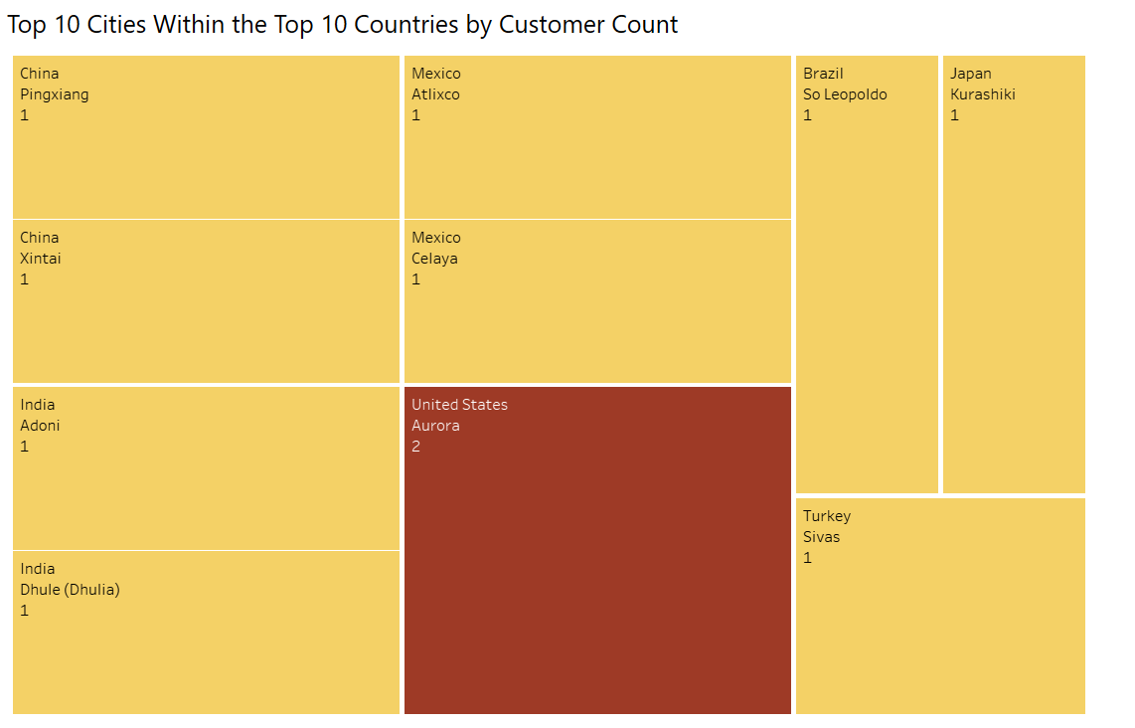
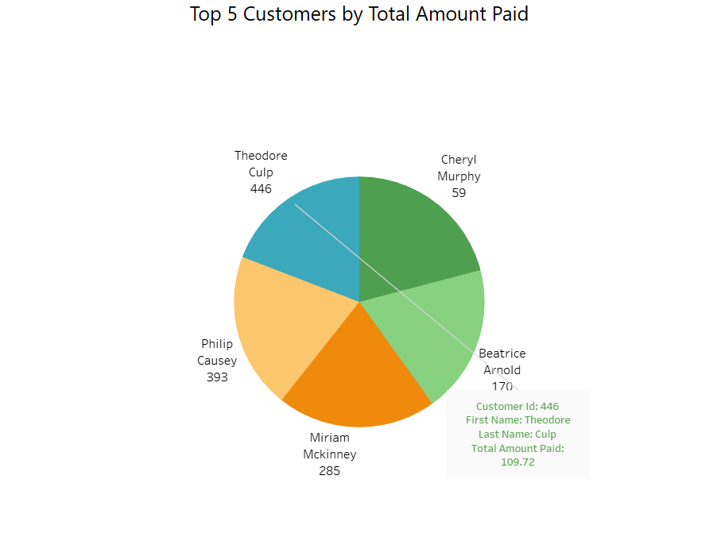
Visualizations and Insights

Slide 9
Overview of Payment Data
Top 10 Cities Within the Top 10 Countries by Customer Count. Top 5 Customers by Total Amount Paid
Heat Map Chart
Pie Chart
Top 10 Cities Within the Top 10 Countries (Task 3.7, Step )
City Distribution: Majority of cities, including Pingxiang (China), Xintai (China), Atlixco (Mexico), and Adoni (India), have 1 customer each, indicating a dispersed customer base.
Top City: Aurora (United States) stands out with 2 customers, the highest among the top 10 cities.
Geographic Spread: Cities from diverse countries like China, India, Mexico, Brazil, Japan, and Turkey are represented, showcasing global reach.
Limited Concentration: The equal representation of most cities suggests low concentration of customers in specific areas.
Business Opportunity: Identifying cities with minimal customers could guide targeted marketing efforts for expansion.
Top 5 Customers By Total Amount Paid (Task 3.7, Step 3)
Highest Payer: Theodore Culp leads with a total payment of 109.72, highlighting him as a valuable customer.
Significant Contributors: Philip Causey (393) and Miriam McKinney (285) are also key revenue contributors..
Diverse Spending: Payments vary widely, from 109.72 to 59, suggesting diverse purchasing behaviors..
Revenue Insights: Focusing on top-paying customers like Theodore Culp can optimize customer relationship management.
Potential Loyalty Programs: Implementing loyalty programs for top spenders could enhance retention and increase spending.

Slide 10

PREDICTION Based on our Tableau visualizations, we predict that countries like India and China will continue to dominate customer growth, making them key markets for expansion. The disparity between total amounts and payments suggests potential outstanding balances, highlighting the need for improved payment collection strategies. Additionally, top-paying customers indicate that a loyalty program could increase retention and spending patterns.
Conclusion
Our analysis provides valuable insights into customer demographics, payment trends, and market opportunities. By focusing on high-growth regions, optimizing pricing strategies, and strengthening customer engagement, we can drive sustainable business growth. Leveraging these insights will help maintain a competitive edge and ensure long-term success

Slide 11





Thank You
Owais Iqbal
+92 3332928391
owaisiqbal2928@gmail.com
https://public.tableau.com/app/profile/owais.iqbal7849

